Slide 1
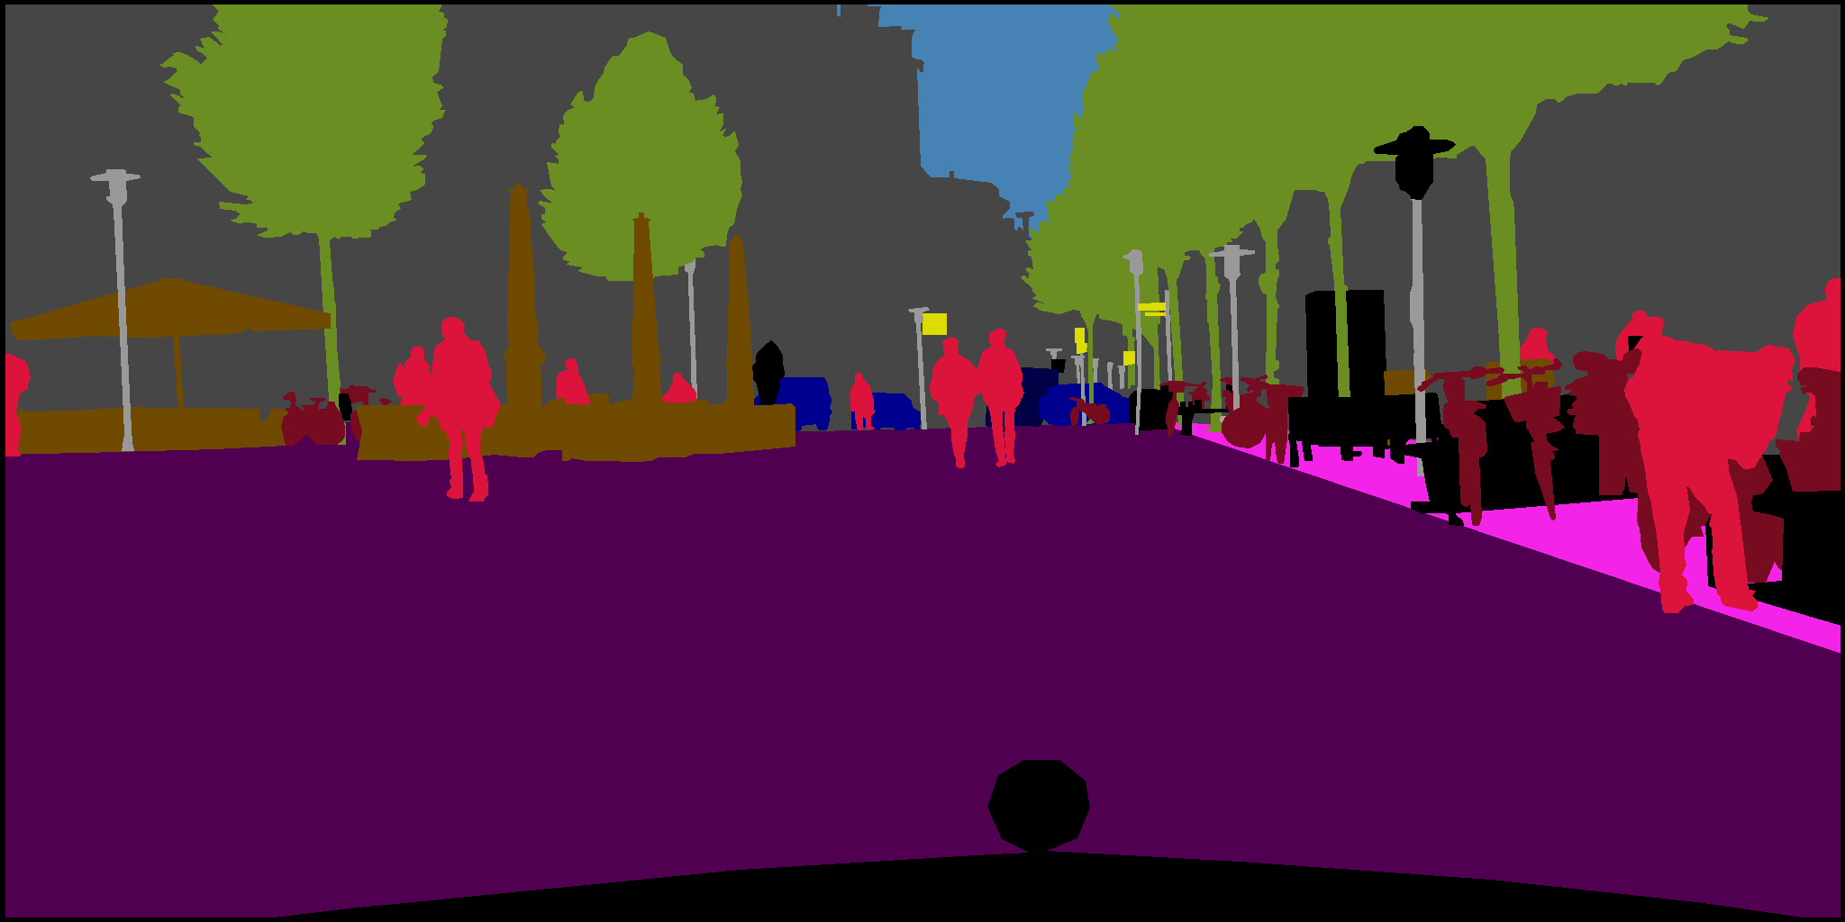
Pixellevel Semantic Segmentation with PixelNet on CityScapes
Marius Cordts et al., 2016

Slide 2
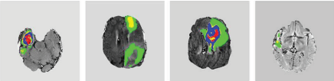
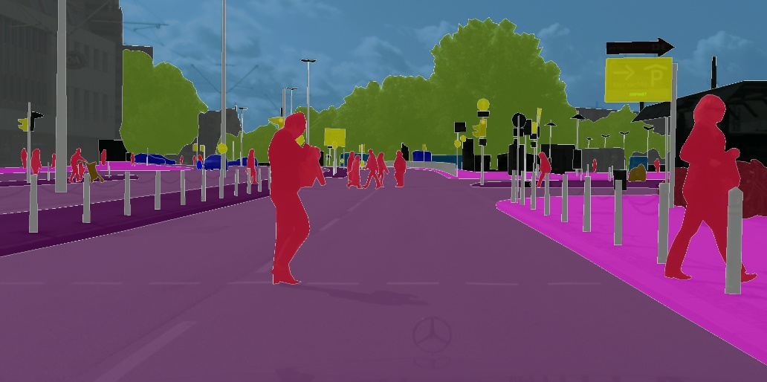
The Importance of Semantic Segmentation
Semantic Segmentation
Partition the image into semantically meaningful parts in order to classify each part
Automatic Cancer Segmentation
Shaoguo Cui et al., 2018
Autonomous Driving
Marius Cordts et al., 2016
Notes:
Important task for different areas of applications
Robotics
Autonomous driving

Slide 3
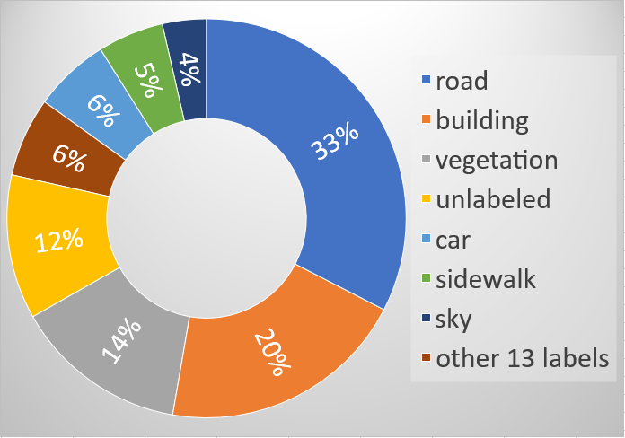
CityScapes: Dataset Overview
5000 fine annotated images of street scenes (2950 for training)
50 different cities, primarily in Germany
34 labels (19 considered while training/ evaluation)
Aspect ratio 2:1 (2048x1024)
uneven class distribution

Slide 4
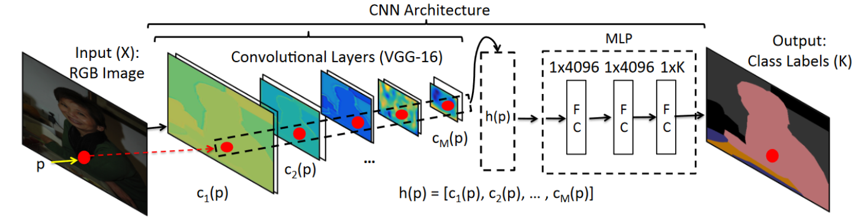
PixelNet: Architecture
Aayush Bansal et al., 2016
1
Input image fed into pretrained VGG16
2
Extraction of hypercolumn features for each Pixel
(during training a small subset of pixels is randomly sampled)
3
MLP predicts label for each particular hypercolumn feature
4
Output: class label for each input pixel of MLP
Notes:
The original architecture of PixelNet is composed of convolutional layers (VGG-16) after the input image.
These layers extract a so-called hypercolumn descriptor which then goes into a multilayer perceptron (MLP) for the nonlinear optimization. The hypercolumn descriptor consists of several features extracted from the convolutional layers.
The last layer of the MLP then generates the respective output for the given task.

Slide 5
Our work
Implementing PixelNet with Tensorflow from scratch
Implementing training and evaluation environment
Training and tuning PixelNet on CityScapes dataset
Evaluation of results

Slide 6
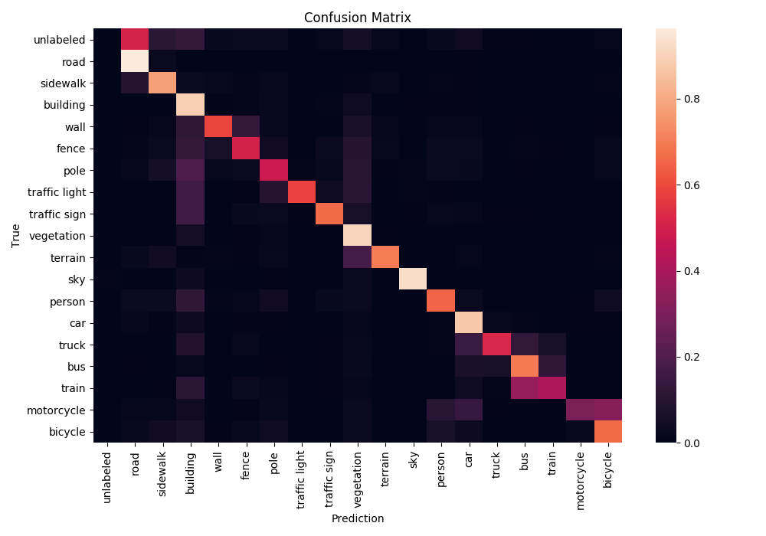
Results: Confusion matrix
Training:
Mean IoU: 73.95%
Validation:
Mean IoU: 43.2%
Weighted IoU: 59.2%
Category IoU: 69.9%
Notes:
Smaller objects are more difficult to classify
Vehicles are mistaken for each other
Sampling makes it harder to learn infrequent classes (e.g. pole)
Categorical detection works well

Slide 7
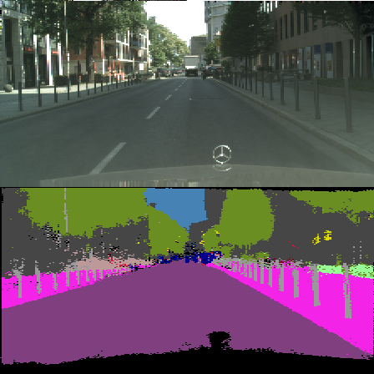
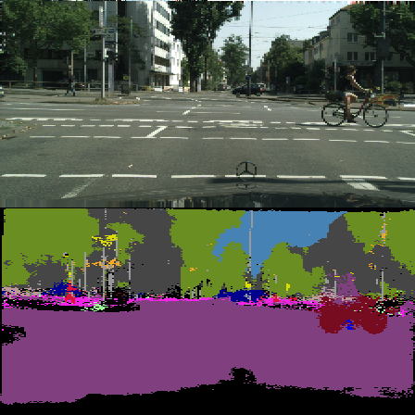
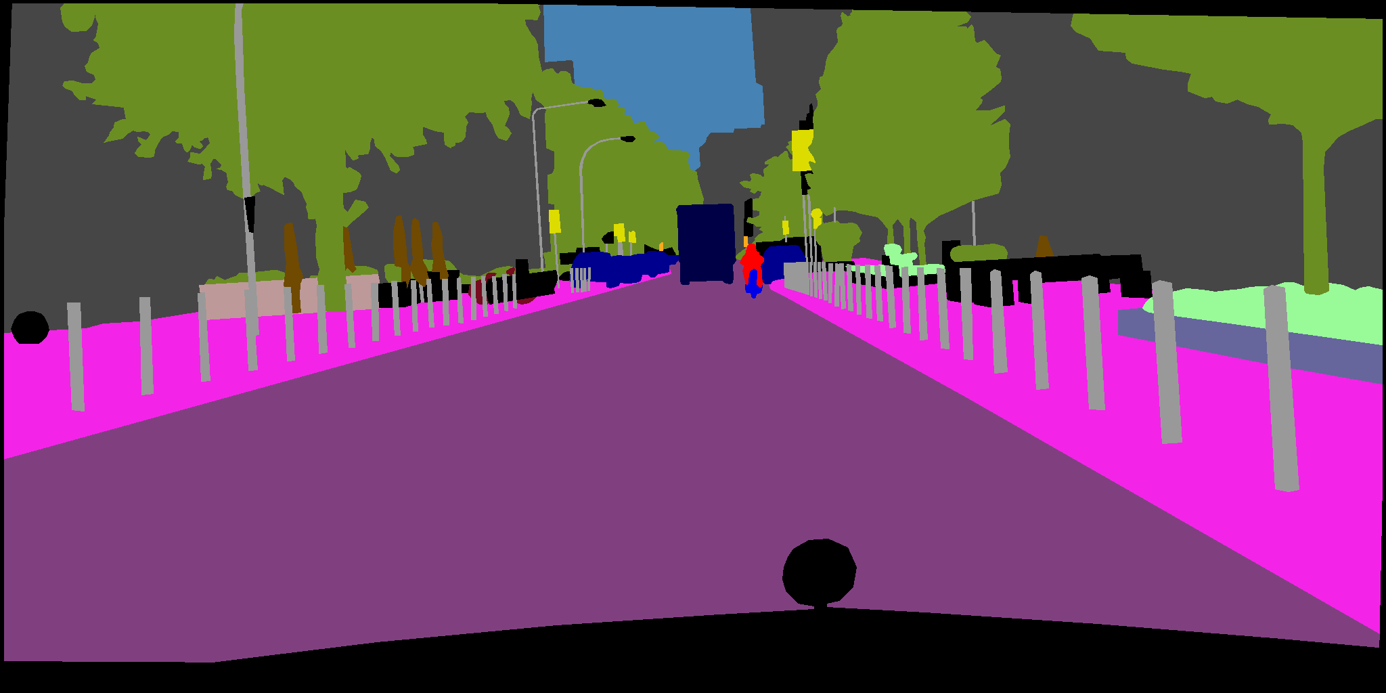
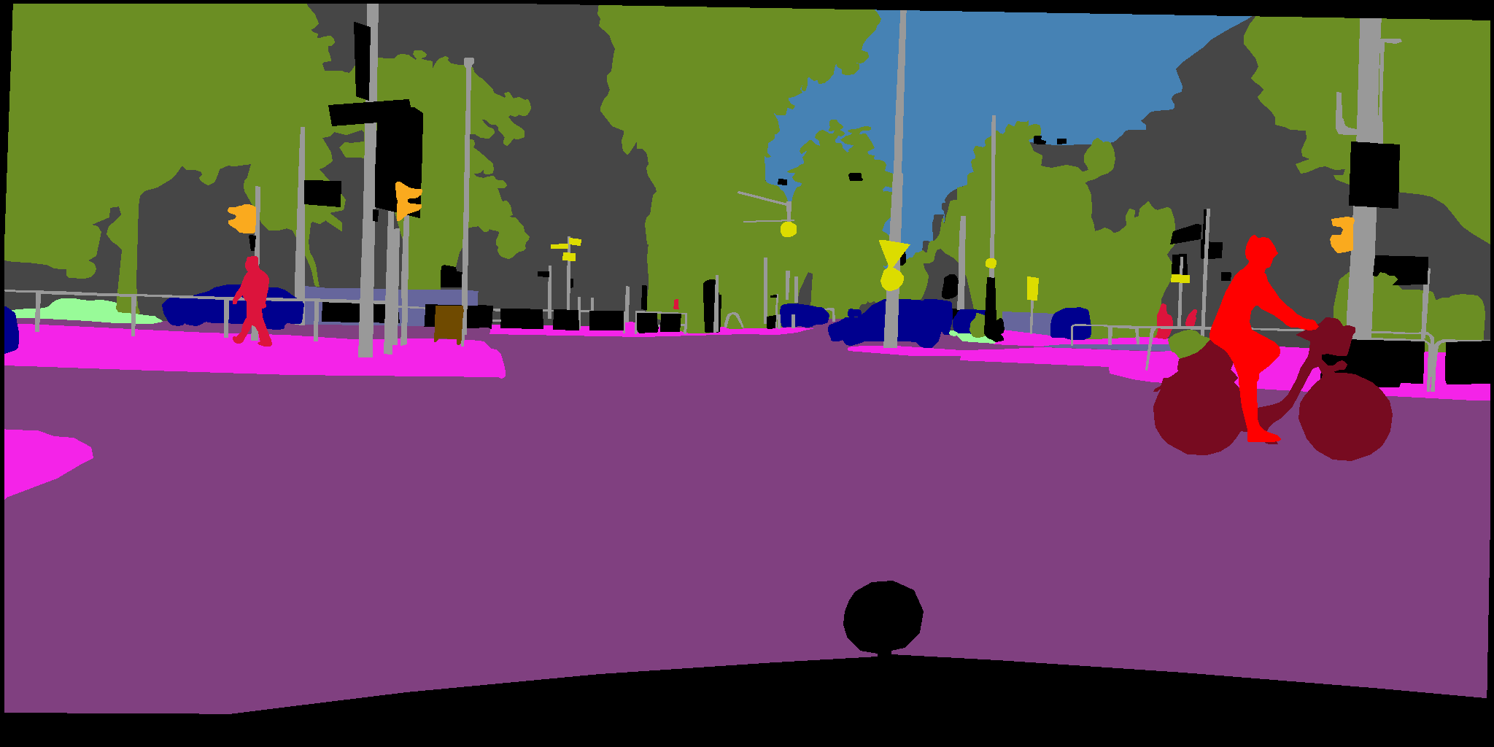
Results: Examples
Input Image
Prediction
Ground Truth
Notes:
Resizing of input images reduces size of small objects
Occlusion and number of objects influence prediction quality

Slide 8
Outlook
Weighted loss function/ oversampling
Loss still improving → longer training on GPUs
Replacing the VGG-16 architecture with a ResNet Implementation
Ignore background labels during training

Slide 9
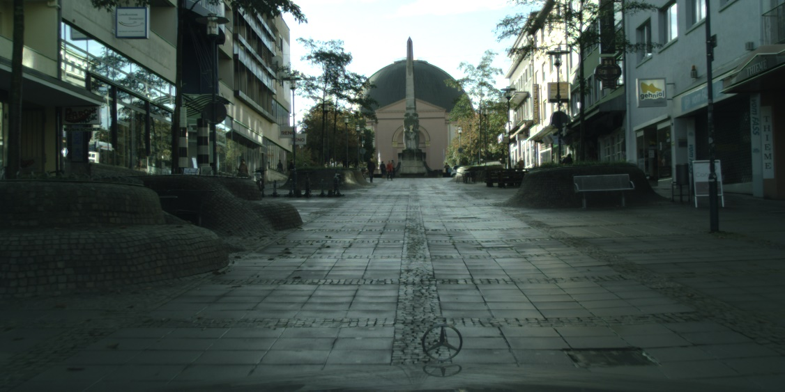
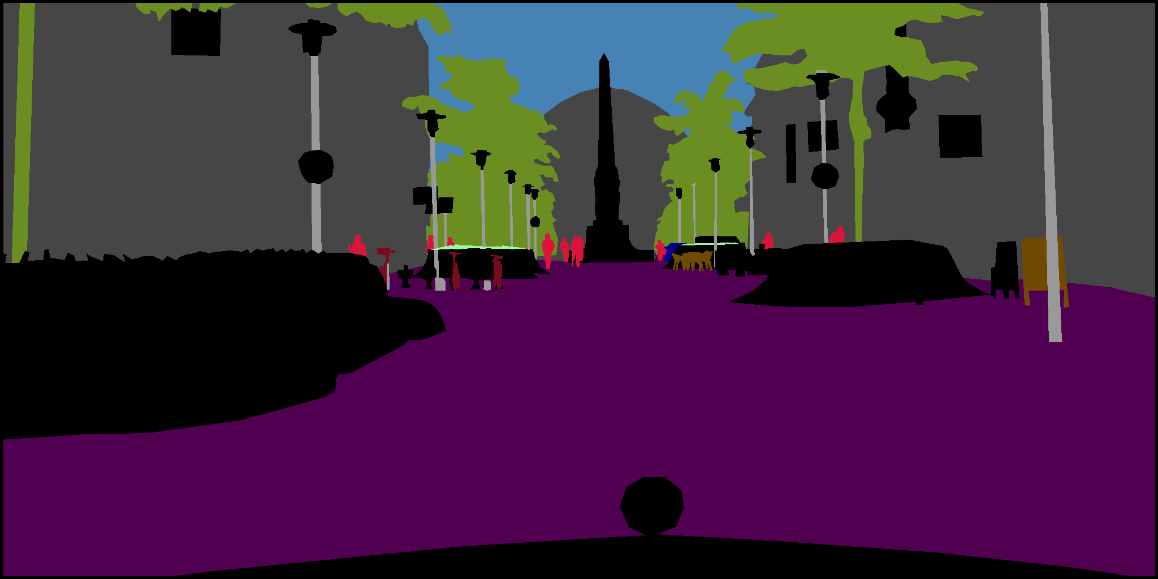
questions?
Marius Cordts et al., 2016

Slide 10
Bibliography
Cordts, Marius; Omran, Mohamed; Ramos, Sebastian; Rehfeld, Timo; Enzweiler, Markus; Benenson, Rodrigo et al.: The Cityscapes Dataset for Semantic Urban Scene Understanding. Available online at http://arxiv.org/pdf/1604.01685v2.
Shaoguo Cui, Lei Mao, Jingfeng Jiang, Chang Liu, and Shuyu Xiong, “Automatic Semantic Segmentation of Brain Gliomas from MRI Images Using a Deep Cascaded Neural Network,” Journal of Healthcare Engineering, vol. 2018, Article ID 4940593, 14 pages, 2018. https://doi.org/10.1155/2018/4940593
Bansal, Aayush; Chen, Xinlei; Russell, Bryan; Gupta, Abhinav; Ramanan, Deva: PixelNet. Towards a General Pixel-level Architecture. Available online at http://arxiv.org/pdf/1609.06694v1.

